Slide 1
Describing a reflection
Transformations

Slide 2
how to use Oak lessons

Slide 3
I can understand the minimum information required to describe a reflection.

Slide 4
We will explore what line of reflection means later in the lesson.
We will explore what equidistant means later in the lesson.

Slide 5

Describing a reflection
Describing a reflection with formal language
Applying strategies for finding the mirror line
Diagonal reflections and non-reflections

Slide 6
Describing a reflection with formal language
When an object is reflected, the image can be any distance away from the object.

Slide 7
Describing a reflection with formal language
This dotted line is used to define the location of the reflection.
What is the name of this line?
mirror line or
line of reflection

Slide 8
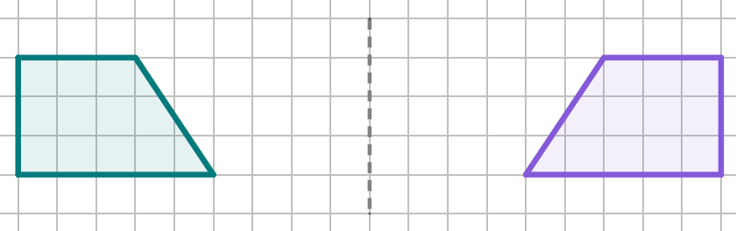
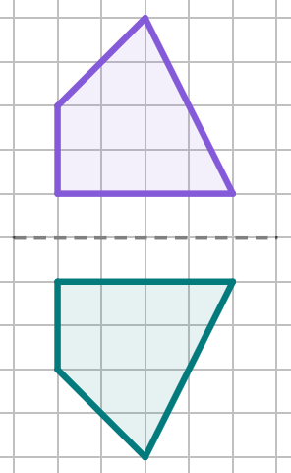
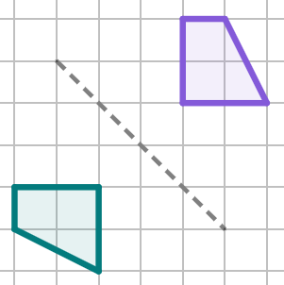
Describing a reflection with formal language
There are three types of reflection:
horizontal
This type of reflection happens when a shape is reflected either left or right
vertical
diagonal
This type of reflection happens when a shape is reflected either up or down
This type of reflection happens when a shape is reflected diagonally

Slide 9
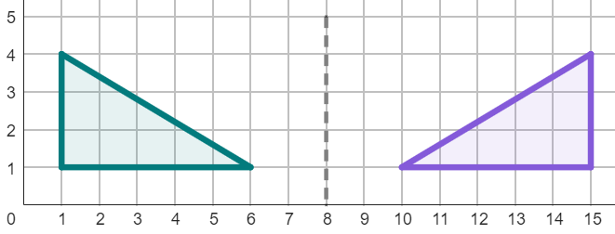
Describing a reflection with formal language
Three pieces of information are needed to describe a reflection:
1) state it is a reflection
2) state whether the reflection horizontal, vertical, or diagonal
3) describe the location of the line of reflection with two coordinates
This is a horizontal reflection,
with a line of reflection that passes through (8, 0) and (8, 3).

Slide 10
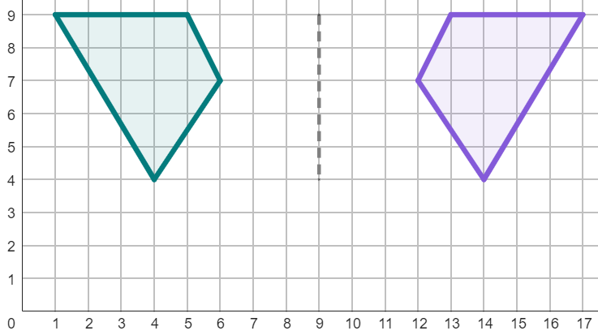
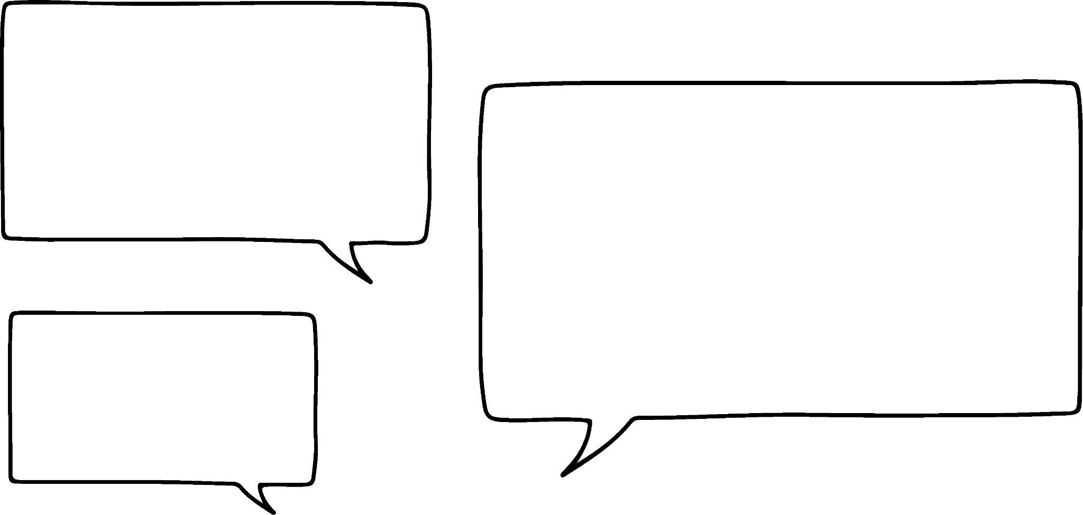
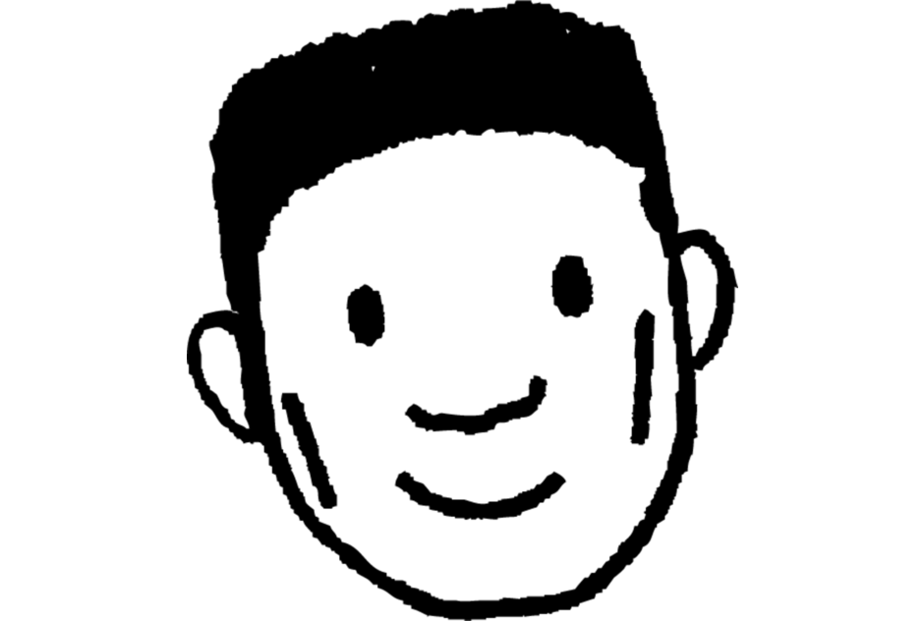
Describing a reflection with formal language
Complete Lucas’ description of the reflection.
horizontal
This is a . reflection in the line that passes through the coordinates ( , 4) and (9, 9).
9
Lucas

Slide 11

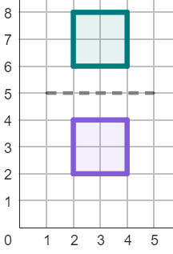
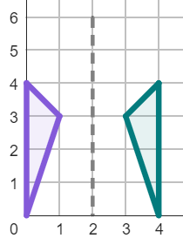
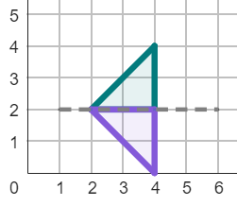
Describing a reflection with formal language
1) Match the descriptions to the reflections.
a
b
Description 1
Horizontal reflection
Line of reflection through the coordinates (2, 5) and (2, 0).
Description 2
Vertical reflection
Line of reflection through the coordinates (5, 2) and (0, 2).
c
Description 3
Vertical reflection
Line of reflection through the coordinates (2, 5) and (0, 5).

Slide 12
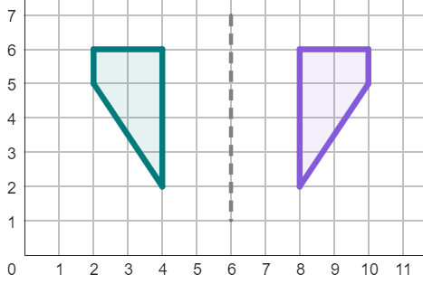
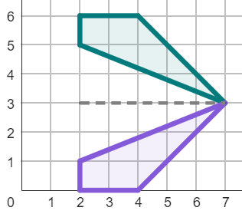
Describing a reflection with formal language
2) Complete the descriptions of these reflections.
Description 1
reflection
Line of reflection through the
coordinates ( , 5) and ( , 1).
Description 2
.
Line of reflection through the
coordinates ( , ) and ( , ).

Slide 13
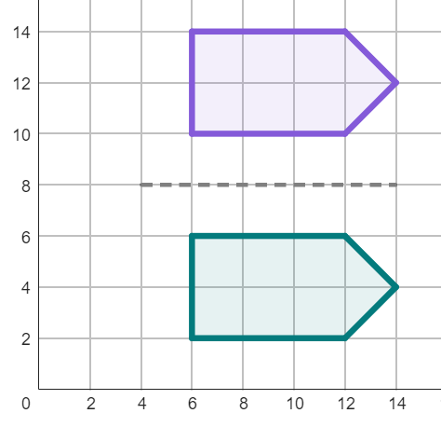
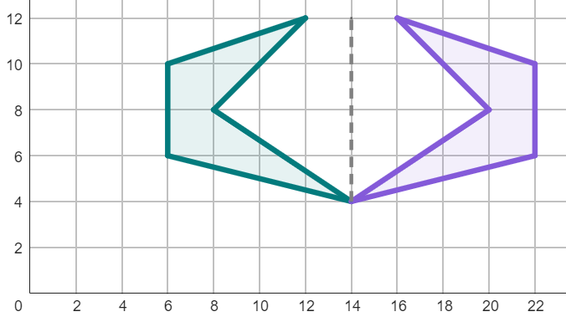
Describing a reflection with formal language
3) Write full descriptions to these reflections.
Description 1
Description 2

Slide 14
Describing a reflection with formal language
1) Match the descriptions to the reflections.
a
b
Description 1
b
Horizontal reflection
Line of reflection through the coordinates (2, 5) and (2, 0).
Description 2
c
Vertical reflection
Line of reflection through the coordinates (5, 2) and (0, 2).
c
Description 3
a
Vertical reflection
Line of reflection through the coordinates (2, 5) and (0, 5).

Slide 15
Describing a reflection with formal language
2) Complete the descriptions of these reflections.
Description 1
horizontal
reflection
Line of reflection through the
coordinates ( , 5) and ( , 1).
6
6
Description 2
vertical
reflection
.
Line of reflection through the
coordinates ( , ) and ( , ).
m
3
n
3
m and n can be any number.

Slide 16
Describing a reflection with formal language
3) Write full descriptions to these reflections.
Description 1
Vertical reflection
Line of reflection through the coordinates (m, 8) and (n, 8).
m and n can be any number.
Description 2
Horizontal reflection
Line of reflection through the coordinates (14, a) and (14, b).
a and b can be any number.

Slide 17
Describing a reflection
Describing a reflection with formal language
Applying strategies for finding the mirror line
Diagonal reflections and non-reflections

Slide 18
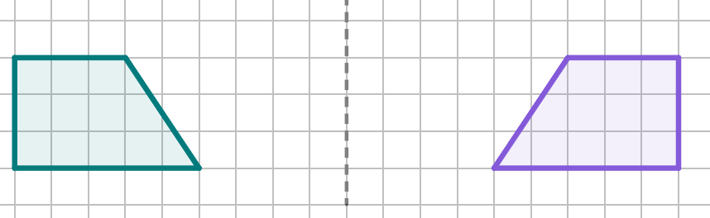
Applying strategies for finding the mirror line
Both the object and image are equidistant from the line of reflection.
equi means equal
distant means distance
A corresponding point on the object and image are an equal distance from the line of reflection.
6 squares
6 squares
4 squares
4 squares

Slide 19
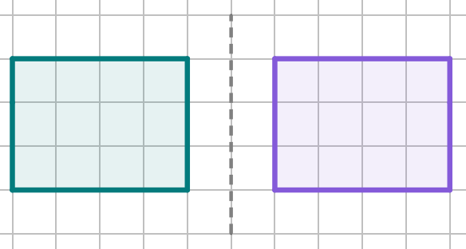
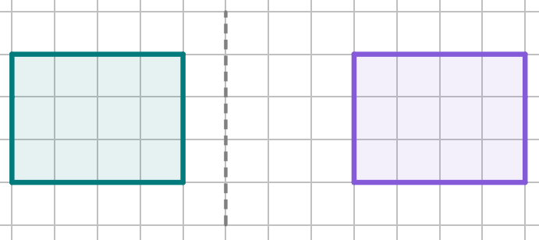
Applying strategies for finding the mirror line
Example
This is a line of reflection, as the object and image are both equidistant from the line of reflection.
Non-example
This is not a line of reflection, as the object and image are both different distances from the line of reflection.

Slide 20
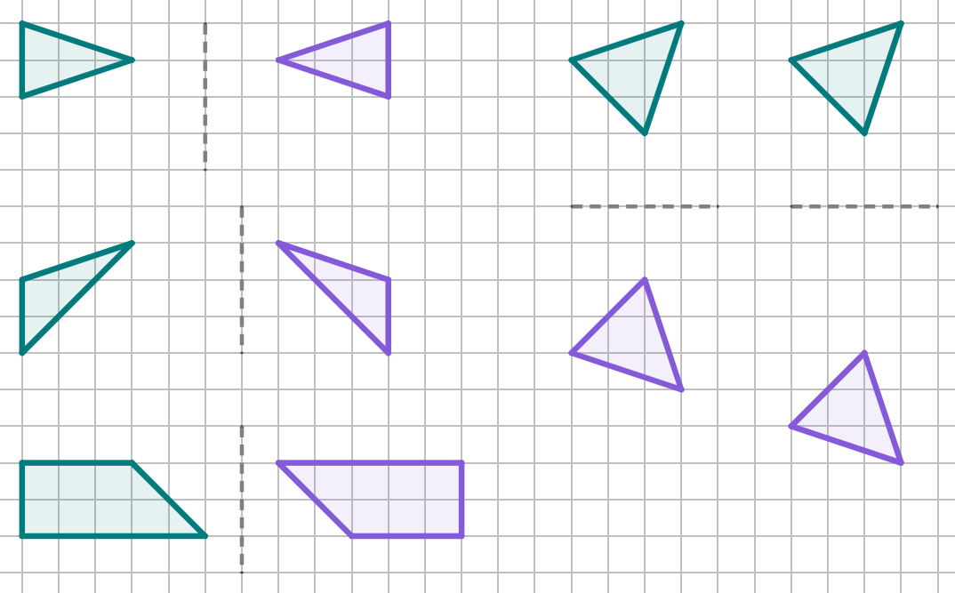

Applying strategies for finding the mirror line
Which of these are examples of lines of reflection?
d
e
a
b
c

Slide 21
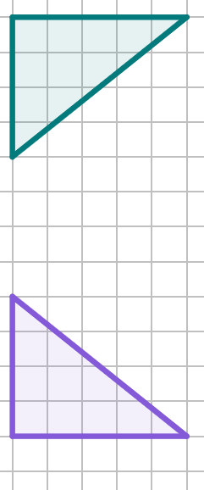
Applying strategies for finding the mirror line
The line of reflection is always in the middle of two corresponding points on the object and image.
We can find the line of reflection by:
1) picking a pair of corresponding points and connecting them with a line segment
Half of 4 squares is 2 squares
2) finding the distance halfway between the two points on the line segment

Slide 22
Applying strategies for finding the mirror line
The line of reflection is always in the middle of two corresponding points on the object and image.
We can find the line of reflection by:
3) repeating a second time for a different pair of corresponding points
Half of 12 squares is 6 squares
4) joining all the midpoints - this is your line of reflection

Slide 23

Applying strategies for finding the mirror line
We can use the same method even if there are no gridlines to help.
It will be necessary to use a ruler to measure the line segments and find the midpoint of each one.
connect two corresponding points with a line segment
use a ruler to measure the length of the line segment
find the midpoint by halving the length on the ruler
repeat and connect the midpoints
line of reflection

Slide 24
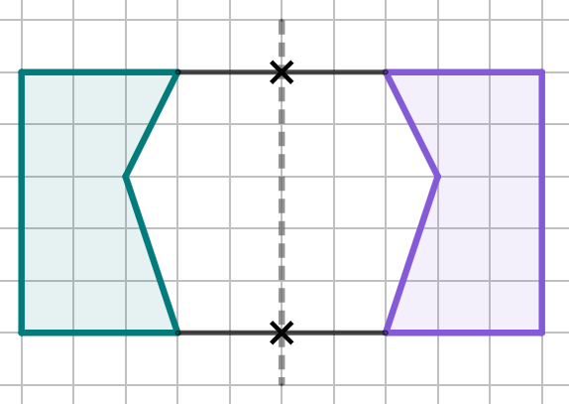
Applying strategies for finding the mirror line
Label the diagram with the correct words from below:
object
c
midpoint
line of reflection
equidistant
line segment
b
a

Slide 25
Applying strategies for finding the mirror line
Label the diagram with the correct words from below:
line of reflection
object
c
equidistant
midpoint
b
line segment
a

Slide 26
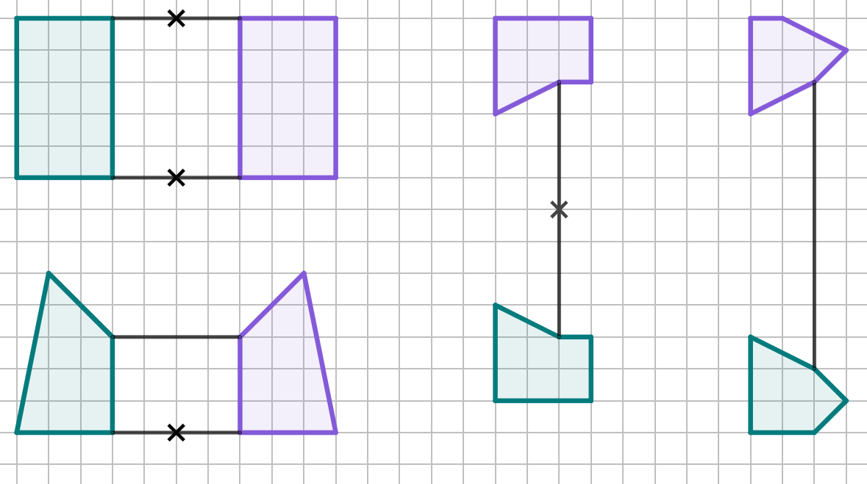
Applying strategies for finding the mirror line
1) Find the line of reflection for each of these partially completed diagrams.

Slide 27
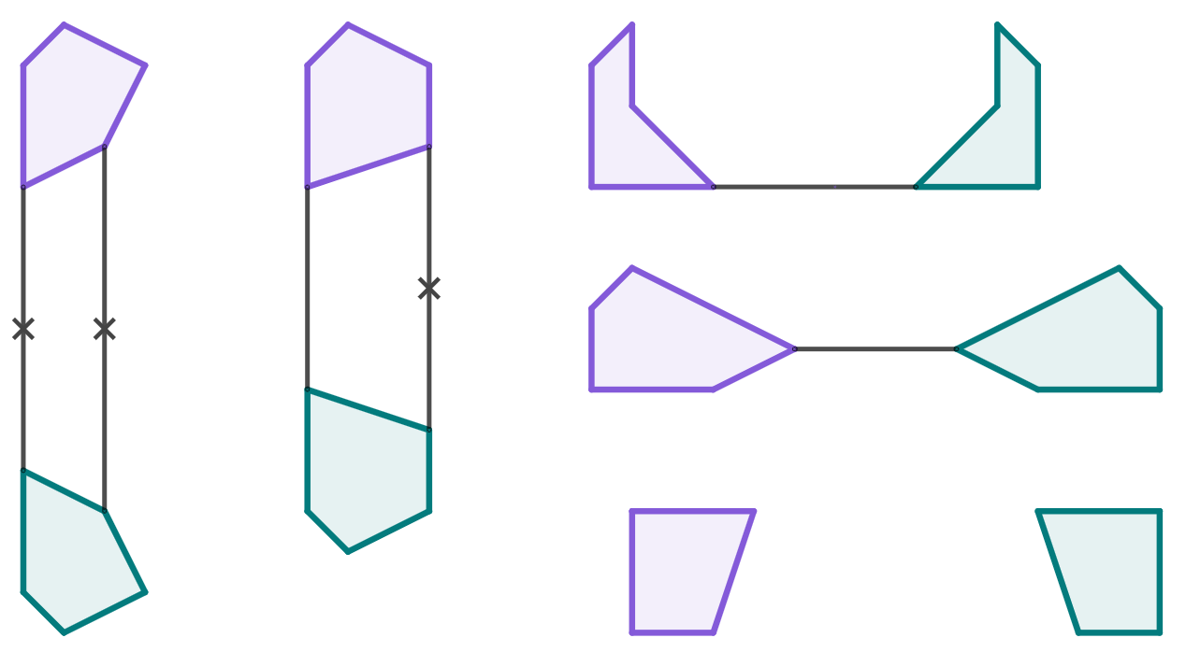
Applying strategies for finding the mirror line
2) Find the line of reflection for each of these partially completed diagrams. You will need to use a ruler.

Slide 28
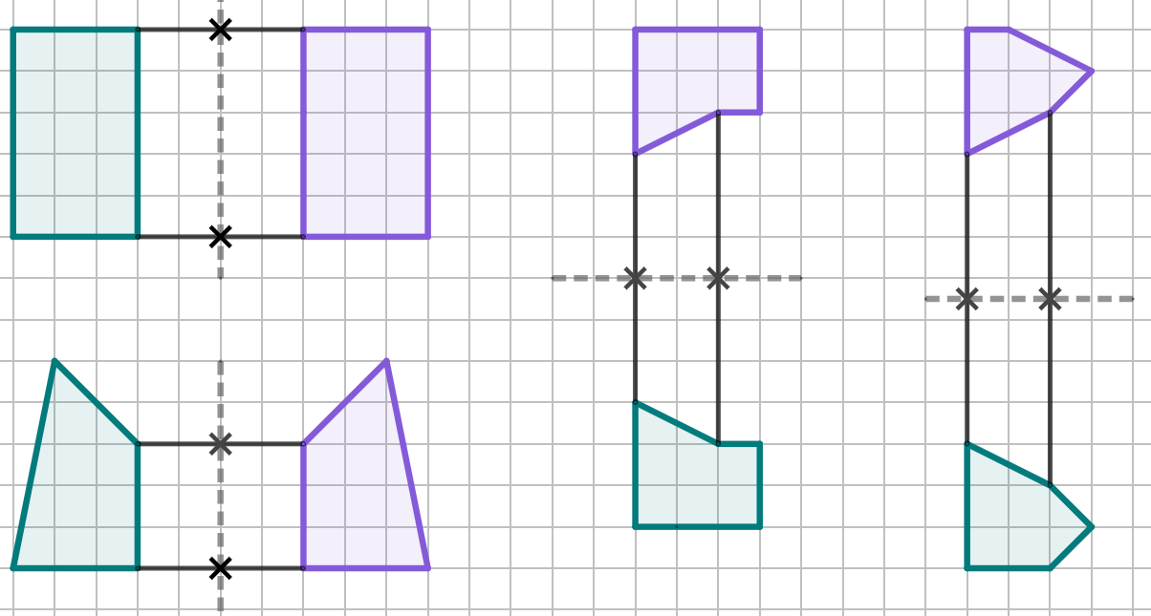
Applying strategies for finding the mirror line
1) Find the line of reflection for each of these partially completed diagrams.

Slide 29
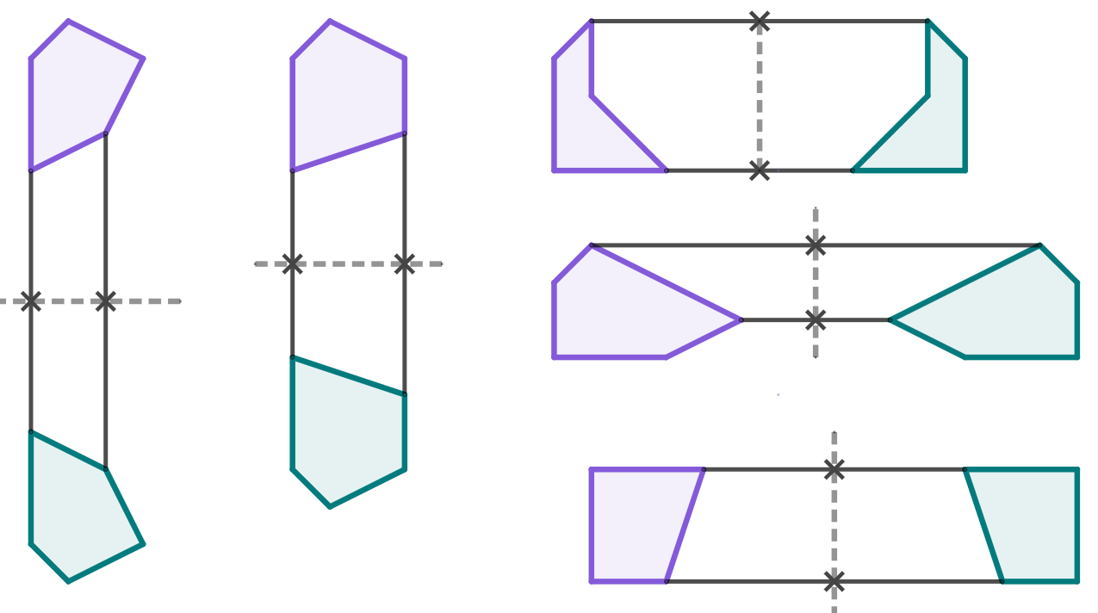
Applying strategies for finding the mirror line
2) Find the line of reflection for each of these partially completed diagrams. You will need to use a ruler.
There will be other correct answers, depending on which pairs of corresponding points you chose.

Slide 30
Describing a reflection
Describing a reflection with formal language
Applying strategies for finding the mirror line
Diagonal reflections and non-reflections

Slide 31
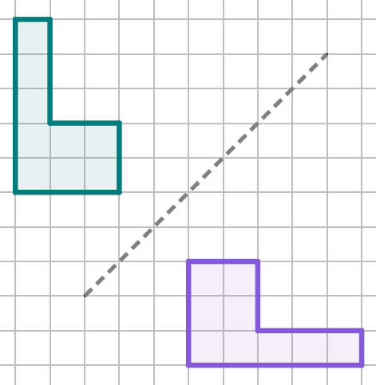
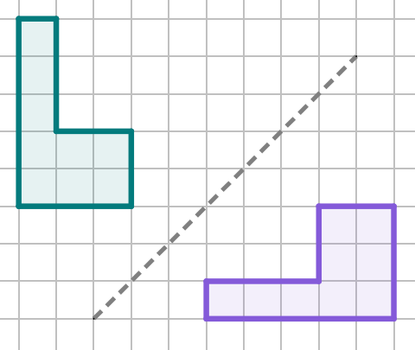
Diagonal reflections and non-reflections
Diagonal reflections can be tricky to identify.
Which of these is a correct reflection?
It is easier to spot diagonal reflections by rotating the diagram or piece of paper.

Slide 32
Diagonal reflections and non-reflections
Diagonal reflections can be tricky to identify.
Which of these is a correct reflection?
It is easier to spot diagonal reflections by rotating the diagram or piece of paper.

Slide 33
Diagonal reflections and non-reflections
Diagonal reflections can be tricky to identify.
Which of these is a correct reflection?
It is easier to spot diagonal reflections by rotating the diagram or piece of paper.

Slide 34
Diagonal reflections and non-reflections
Diagonal reflections can be tricky to identify.
Which of these is a correct reflection?
It is easier to spot diagonal reflections by rotating the diagram or piece of paper.

Slide 35
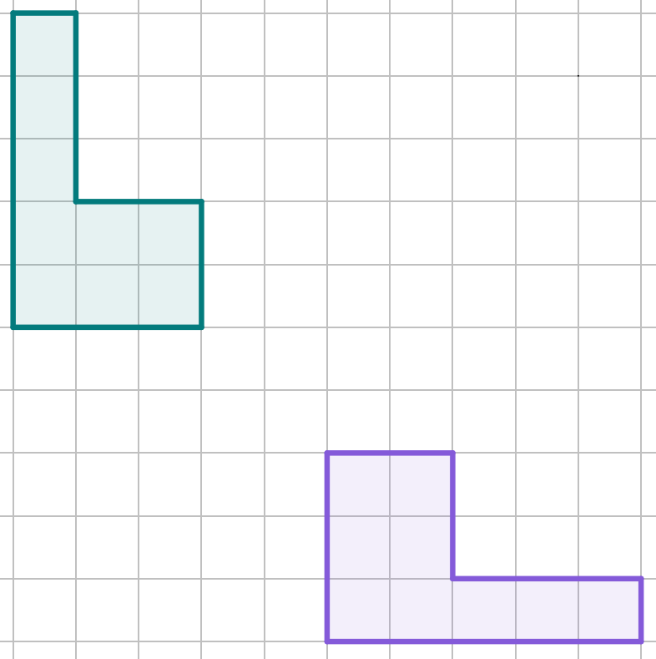
Diagonal reflections and non-reflections
We can also check if a diagonal reflection is correct by drawing line segments between corresponding points (like before).
When using a grid with grid lines, you need to count the diagonals of the grid squares.
4 diagonal squares
2 diagonal squares

Slide 36
Diagonal reflections and non-reflections
When using a grid with grid lines, you need to count the diagonals of the grid squares.
Sometimes, you need to count half-square diagonals, too!
This may mean midpoints end up in the centre of a grid square.
Half of 9 diagonal squares is 4.5 squares

Slide 37
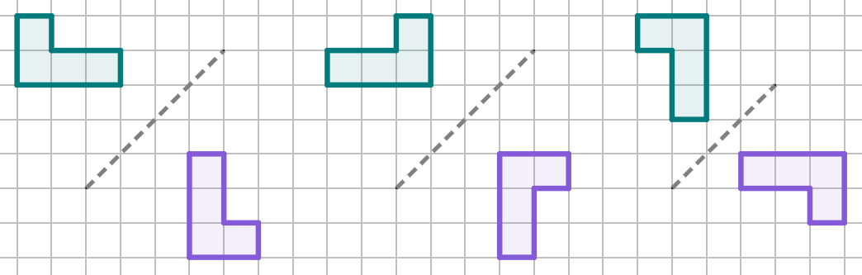
Diagonal reflections and non-reflections
Match the diagonal reflections to their counterparts whose diagrams have been rotated to make the reflections look horizontal.
a
b
c
1
2
3

Slide 38
Diagonal reflections and non-reflections
Match the diagonal reflections to their counterparts whose diagrams have been rotated to make the reflections look horizontal.
a
b
c
3
1
2

Slide 39
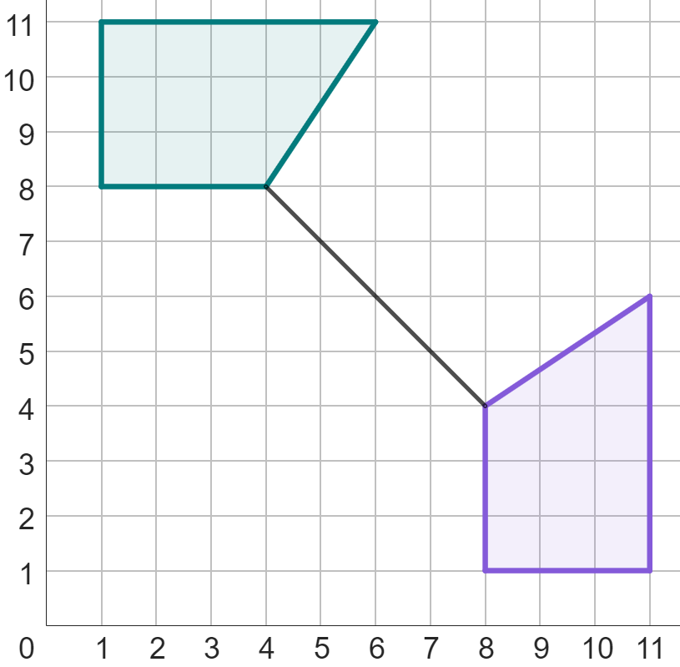
Diagonal reflections and non-reflections
Write down the coordinate of the midpoint for this line segment that connects a pair of corresponding points.
(6, 6)

Slide 40
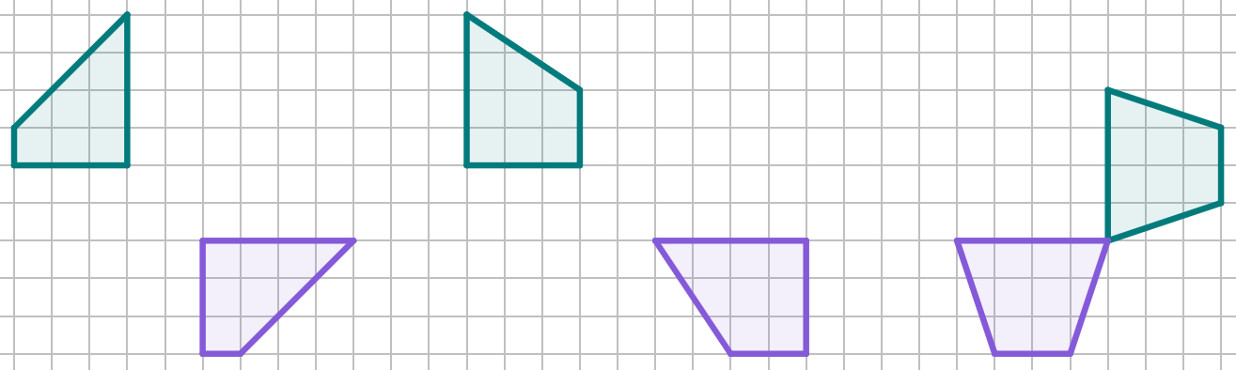
Diagonal reflections and non-reflections
1a) Which of these is a non-reflection? Draw line segments between corresponding points to find out!
b) Draw the line of reflection for all diagrams that show a reflection.

Slide 41
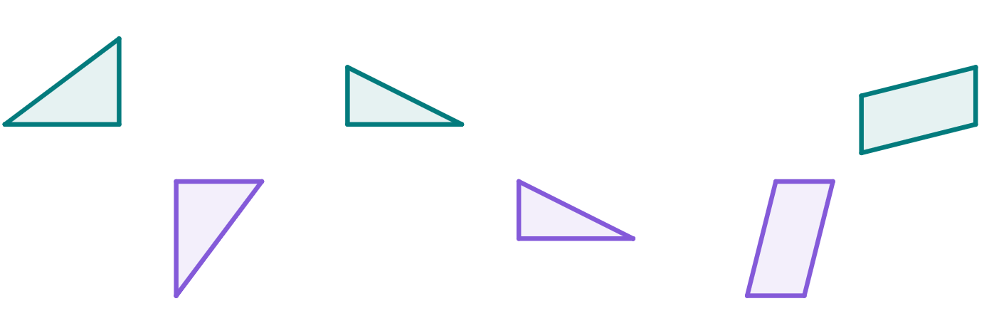
Diagonal reflections and non-reflections
2a) Which of these is a non-reflection? Use a ruler to help you find out!
b) Draw the line of reflection for all diagrams that show a reflection.

Slide 42


Diagonal reflections and non-reflections
1a) Which of these is a non-reflection? Draw line segments between corresponding points to find out!
b) Draw the line of reflection for all diagrams that show a reflection.

Slide 43
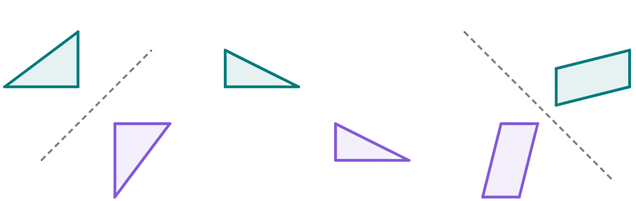
Diagonal reflections and non-reflections
2a) Which of these is a non-reflection? Use a ruler to help you find out!
b) Draw the line of reflection for all diagrams that show a reflection.

Slide 44
Describing a reflection
The line of reflection is essential in defining the location of an image after reflection.
A line of reflection can be described using any two coordinates that lie on that line.
Acknowledging that an object and image are equidistant from a line of reflection is essential in finding the mirror line.
Acknowledging that an object and image are equidistant from a line of reflection is essential identifying reflections from non-reflections, especially on diagonal reflections.

Slide 45

© Oak National Academy 2023.
Produced in partnership with Mathematics in Education and Industry.
Licensed on the Open Government Licence v3.0, except where otherwise stated. See Oak terms and conditions.

